Slide 1

Amazon E-Commerce Analysis
Submitted By
GAGAN

Slide 2
Agenda
Problem Statement
Data Description
Key Metrics and Visualizations
Dashboard Report
Recommendation

Slide 3
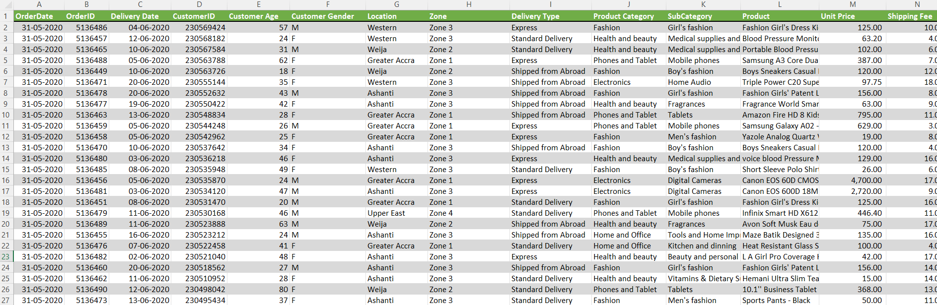
Problem Statement You are working as a business analyst at Amazon, a company currently performing well. The stakeholders wish to maintain this level of performance and seek improvement. For this purpose, they want to devise new strategies. You are part of a team exploring new ways to benefit customers, such as offering more discounts and Prime membership perks. Could you suggest additional methods to identify and reward customers and enhance their shopping experience?

Slide 4
The image above displays details about E-Commerce data, including:
OrderDate: The date when the order was placed.
OrderID: A unique identifier for each order.
Delivery Date: The date when the order is scheduled to be delivered.
CustomerID: A unique identifier for each customer.
Customer Age: The age of the customer.
Customer Gender: The gender of the customer (M for male, F for female).
Location: The geographical area where the customer is located.
Zone: Specific zone within the location for delivery purposes.
Delivery Type: The method by which the order is delivered (e.g., Express, Standard).
Product Category: The broad category to which the product belongs.

Slide 5
The image above displays details about E-Commerce data, including: (Cont..)
SubCategory: A more specific classification within the product category.
Product: The name or description of the product ordered.
Unit Price: The price per unit of the product.
Shipping Fee: The fee charged for shipping the product.
Order Quantity: The quantity of the product ordered.
Sale Price: The total sale price of the order.
Status: Current status of the order (e.g., Delivered, Returned).
Reason: The reason for the return or an empty field if delivered.
Rating: Customer rating for the order on a scale (e.g., 1 to 5).

Slide 6
Data Cleaning and Preparation
Duplicate Records Removal
Removed duplicate records to avoid skewed analysis
Blank Rows and Columns Filtering
Filtered out blank rows and columns to maintain dataset integrity
Handling Null Values
Handled null values by filtering or replacing with 'NA' to prevent errors in calculations
Data Type Verification
Verified and corrected data types for consistency across fields
Ensuring Reliable Analytics
These steps ensure reliable and accurate analytics downstream

Slide 7
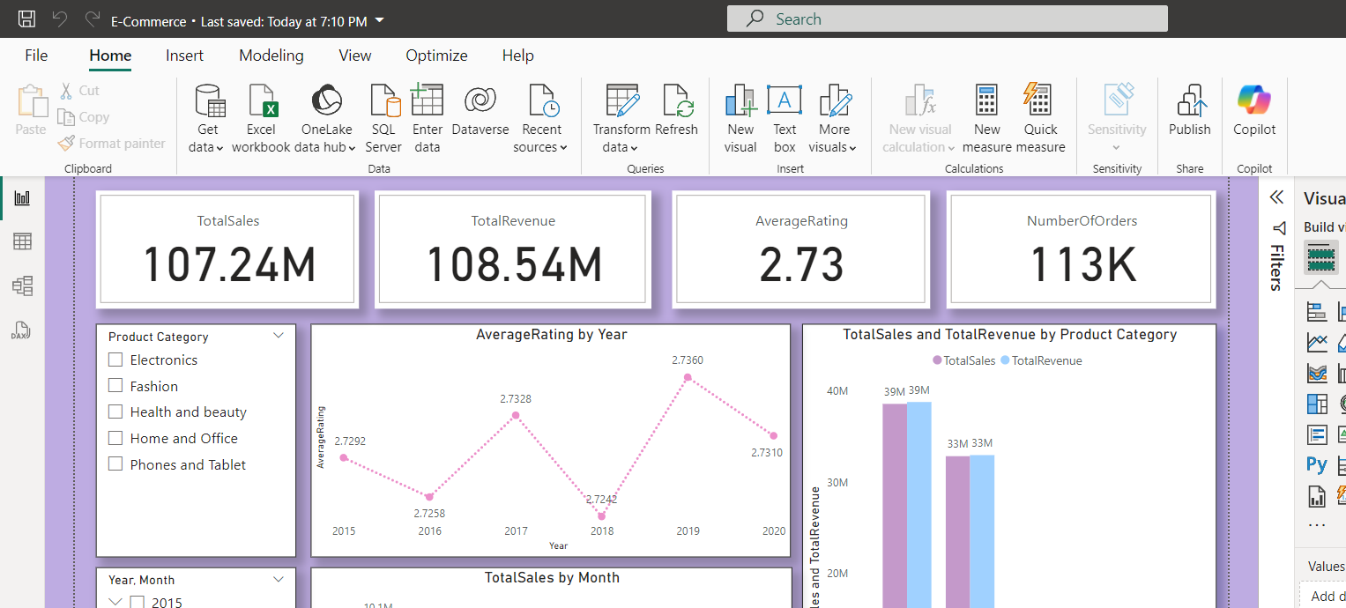
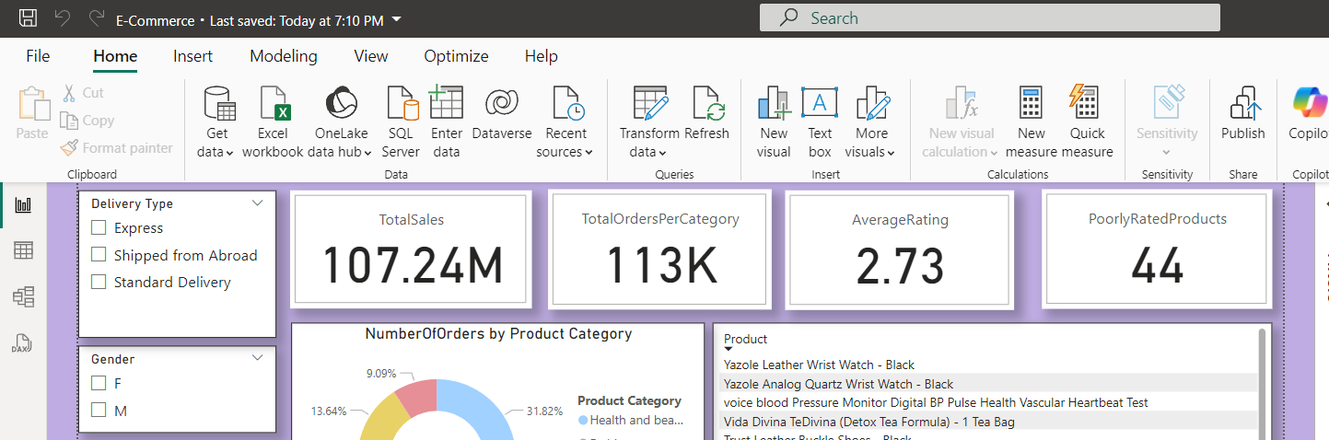
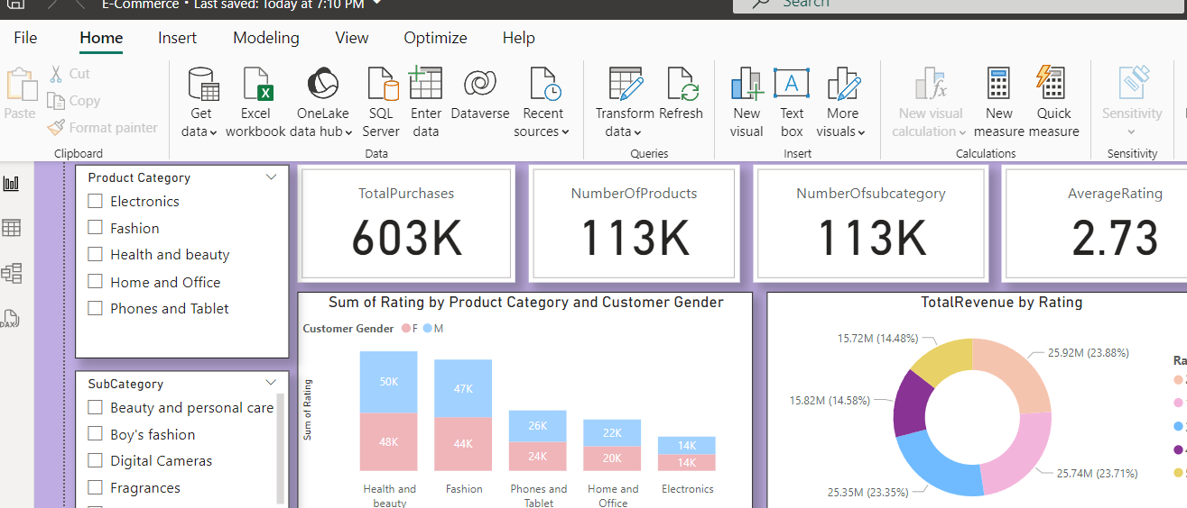
Key Metrics

Slide 8
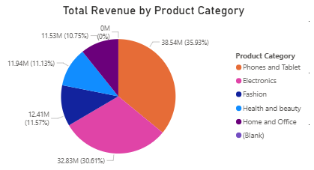
Total Revenue by Product Category
Phones and Tablet(36%) and Electronics(30.6%) are top selling product categories. This indicates that marketing campaigns targeting this category can lead to further sales growth.
Fashion(11.57%) and Health and beauty(11.13%) show moderate sales. These categories have potential for growth by expanding product lines or launching targeted campaigns.
Home and Office products account for 10.75%, indicating lowest among the categories, where it still represents a substantial market.

Slide 9

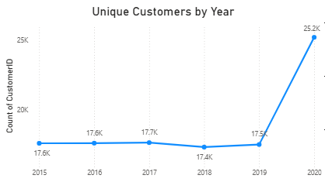
Unique Customers by Year
From 2015 to 2019, the number of unique customers remained relatively stable, fluctuating between 17,400 to 17,700. This suggests that the customer base has remained consistent year over year during this period.
There is a notable increase to 25,200 unique customers in 2020. This suggests a strong increase in customer acquisition.

Slide 10
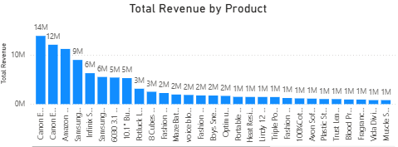
Total Revenue by Product
Canon EOS 600D and Canon EOS 60D DSLR cameras are the highest-selling products, indicating high demand for quality photography equipment.
The Amazon Fire HD 8 Kids Tablet and Samsung Galaxy A02 smartphone show strong sales, that reflects customer interest in family-friendly and affordable devices.
Products with sales amounts closer to 1M or 2M may be more focused but still have potential for growth. These products can be used as tailoring marketing strategies or expanding the product line which helps to increase their visibility and sales.

Slide 11
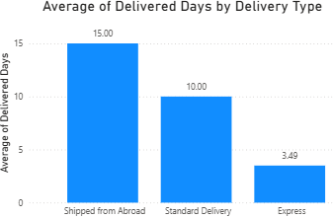
Average Delivered Days by Delivery Type
There is a correlation between average wait times and delivery type between ordering and receiving a product.
This data highlights significant differences in wait times across delivery methods: Shipped from Abroad (15.0) has the longest delivery times, while Express Delivery (3.5) offers the fastest service.

Slide 12
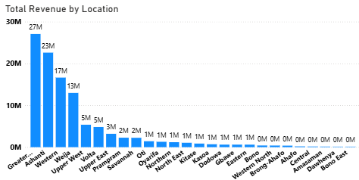
Revenue Distribution
Greater Accra, Ashanti and Western regions have high demand for products, making a key for marketing and business expansion.
Prampram, Savannah, or North East, there are opportunities to increase market share by tailoring strategies to local demands and promoting products more effectively.
Amasaman, Bono East and Dawhenya regions have lower sales, indicating smaller populations or be less commercially developed compared to higher-performing regions.

Slide 13
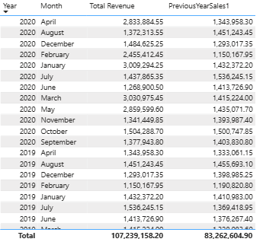
Monthly Sales: Current Year vs Previous Year
The early months of 2020 showed strong sales growth, which could be due to factors like seasonal trends, new product launches have led to increased demand for certain products.
February show lower sales, suggests that benefit from targeted promotions.
Months like May and October show strong performance, indicating potential high demand periods.
July and March have higher sales, due to focusing on promotions or adjusting marketing efforts to counter such declines in the future.

Slide 14
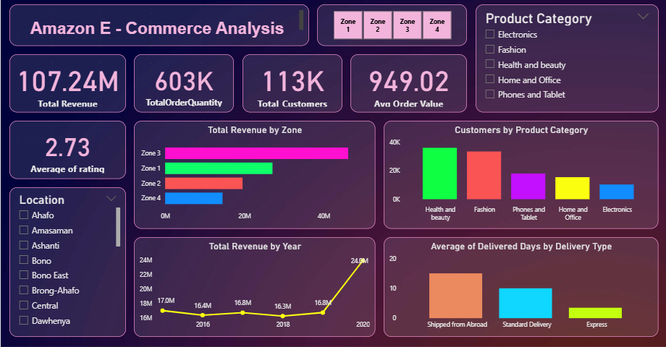
Amazon E-Commerce analysis
dASHBOARD

Slide 15
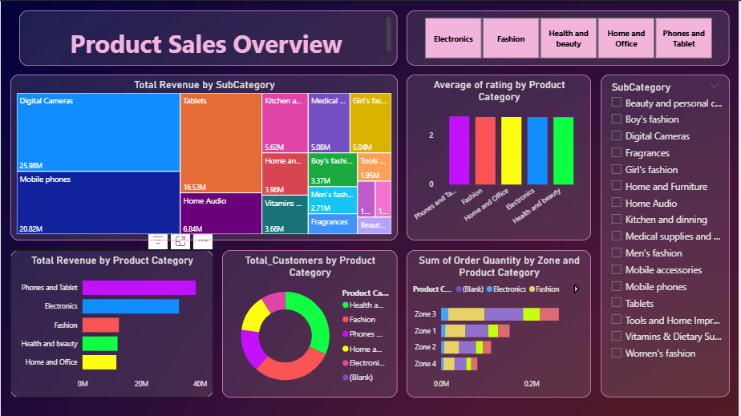
Product Sales Overview

Slide 16
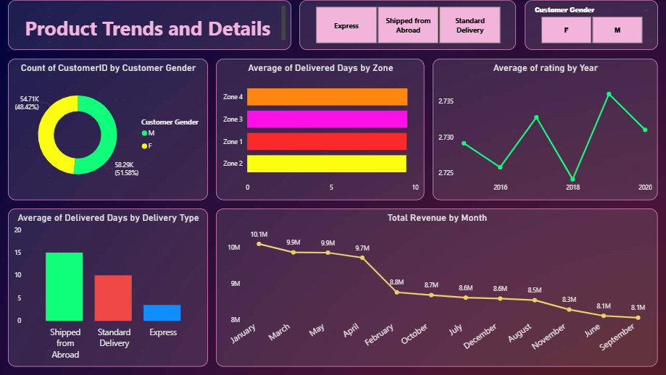
Product Trends and details

Slide 17






Strategic Recommendations
Targeted Marketing Strategies
Leverage product ratings and regional sales data to tailor promotions.
Focus on enhancing customer satisfaction through personalized marketing efforts.
Optimized Inventory Distribution
Use zone-wise analysis to ensure stock availability in high-demand areas like Greater Accra.
Address low-performing regions to balance inventory distribution effectively.
Customer Loyalty Programs
Segment programs by spending capacity to offer VIP perks, reward points, and cashback incentives.
Boost customer retention through tailored loyalty initiatives.
Enhanced Delivery Efficiency
Partner with faster carriers to improve delivery times.
Enhance order tracking and prioritize express shipping during peak periods.
Addressing Product Returns
Strengthen quality control to reduce defects and mismatches.
Improve product descriptions and streamline packaging processes to minimize returns.

Slide 18


